Slide 1
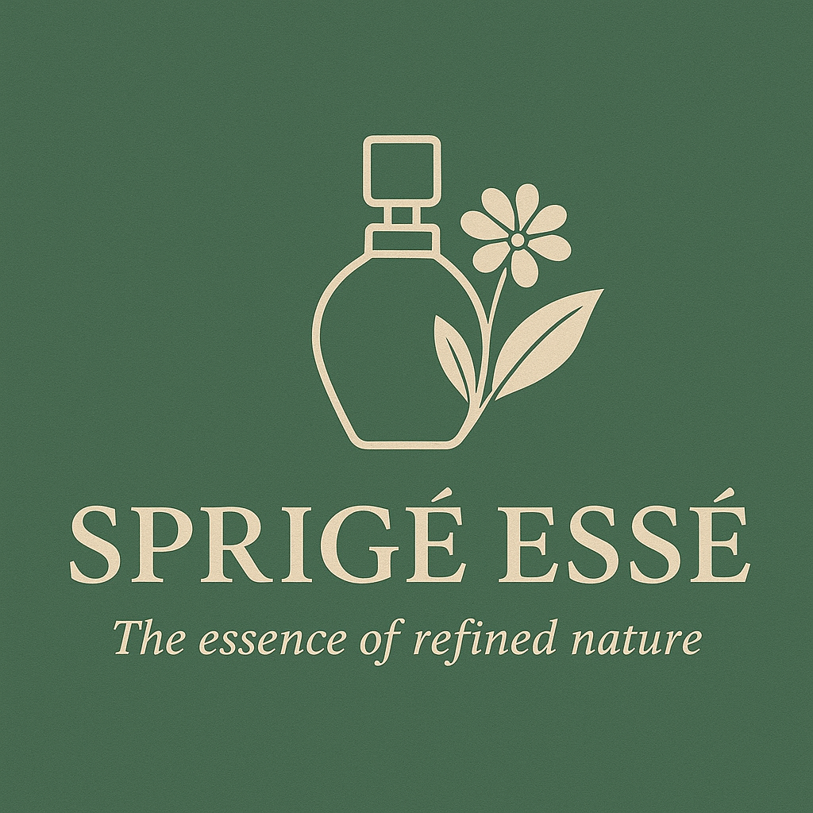

NEHA.S.BABU
GCC DIGITAL MARKETING

Slide 2
Brand Overview
SPRIGÉ ESSÉ
Pronunciation: spree-zhay es-say
Meaning: Inspired by “sprig” and “essé” (essence), representing the pure soul of refined nature.
Tagline
The Essence of Refined Nature

Slide 3
About SPRIGÉ ESSÉ
SPRIGÉ ESSÉ is a premium perfume brand rooted in elegance, nature, and modern refinement. The brand blends botanical inspiration with sophisticated perfumery to create timeless fragrances for individuals who value subtle luxury. SPRIGÉ ESSÉ positions itself as a niche yet aspirational brand, appealing to consumers who seek authenticity, craftsmanship, and emotional connection through scent.

Slide 4
SPRIGÉ ESSÉ Isn’t Just a Perfume, It’s a Signature
In a world full of fragrances that smell good for a moment, SPRIGÉ ESSÉ exists to be remembered.
SPRIGÉ comes from sprig a fresh shoot of nature.
ESSÉ means to be your presence, your essence.

Slide 5
What makes SPRIGÉ ESSÉ different?
.
SPRIGÉ ESSÉ blends nature’s finest elements with modern refinement, creating a fragrance that feels personal, not overpowering. While others are loud and fleeting, this scent is subtle, long-lasting, and unforgettable.
It doesn’t chase trends.
It creates presence

Slide 6
Why SPRIGÉ ESSÉ
Elegance Without Effort SPRIGÉ ESSÉ is for people who don’t need to announce themselves.
It’s for:
The confident, not the noisy
The refined, not the flashy
Those who leave an impression without trying

Slide 7
Long-Lasting, Close to the Skin
The best fragrances don’t shout across the room.
They stay close, warm, and personal—lasting for hours and unfolding slowly.
People lean in.
They ask.
They remember.

Slide 8
A Brand With Soul
SPRIGÉ ESSÉ isn’t mass-produced luxury.
It’s considered luxury every detail intentional
The name
The scent structure
The minimal elegance
It feels expensive because it is thoughtful.

Slide 9
What Makes SPRIGÉ ESSÉ the Best?
It Smells Like Identity, Not Trend
SPRIGÉ ESSÉ fragrances aren’t made to follow fast trends. They’re designed to become your scent the one people recognize before they see you.
Nature, Refined Not Raw
No overpowering notes.
No artificial loudness.
Just quiet luxury

Slide 10
Target Market
Primary Audience
Age: 20–40 years
Gender: Unisex focus
Lifestyle: Urban, style-conscious, premium buyers
Preferences: Niche perfumes, luxury aesthetics, unique brand stories
Secondary Audience
Luxury Perfume collectors
Life style & fashion enthusiasts
              Gift buyers

Slide 11
Marketing Strategy
1 Branding Strategy
Consistent visual identity (logo, colors, typography)
Strong storytelling around nature and refinement
Focus on emotions and experiences rather than loud promotion
2 Digital Marketing Strategy
Social Media Marketing
Platforms:
Instagram
Pinterest
YouTube Shorts / Reels
3 Offline Marketing Strategy
Pop-up stores in premium malls
Presence in concept stores and boutiques
Elegant sampling cards
Luxury gift sets for festivals and special occasions
4 Influencer & Collaboration Strategy
Collaborate with micro-influencers in beauty, fashion, and lifestyle
Partner with content creators who focus on elegance and minimal luxury
Limited-edition collaborations
5 Website & E-commerce Strategy
Clean, minimalist website design
Strong product descriptions with scent storytelling
Easy navigation and mobile optimization
Blog section on fragrance notes and inspiration

Slide 12
Pricing Strategy
Premium pricing to reflect quality and exclusivity
Limited discounts
Focus on value, craftsmanship, and experience
Promotional Strategy
Launch campaigns with storytelling videos
Free samples with first purchases
Loyalty programs for repeat customers
Seasonal campaigns inspired by nature
(Spring, Monsoon, Autumn)

Slide 13
Conclusion
SPRIGÉ ESSÉ is more than a perfume brand. it is an experience of refined nature and quiet luxury. Through thoughtful branding, strategic marketing, and emotional storytelling, the brand aspires to build long-term loyalty and a distinctive presence in the premium fragrance market.

